Slide 1

VENTURE CATALYST
An angel syndicate network dedicated to early-stage, pre-seed
undergraduate startups
2026

Slide 2
THE PROBLEM
The Bridge to Pre-Seed and Accelerators
Student startups need an initial investments to develop MVP, attend conferences/tradeshows with customers, AWS credits or early-marketing to launch their startup- an amount of capital that is less than the traditional pre-seed round. Promising student founders have not yet met the metrics for pre-seed investment but with capital can launch a startup.
$500K–$2.5M
$1.2M
Typical 2026 Pre-Seed round
Median Pre-Seed round
Student startups need a bridge to pre-seed. The typical college student-founded startup cannot justify an initial investment at this size and needs a catalyst to reach this point.
Venture Catalyst can provide the cash to jumpstart a new startup into a viable Techstars or Y Combinator cohort member. Venture Catalyst can act as the bridge to an eventual Pre-Seed or Seed round.
VENTURE CATALYST
2

Slide 3
THE PROBLEM
The Funding Gap for Early Stage Startups
This concentration means the smallest, earliest checks are structurally overlooked by traditional VC — creating a large, growing pool of pre-seed-ineligible founders with nowhere to turn.
70%
6,000+
Pre-Revenue
of 2025 U.S. VC funding (≈$200B) went to just 389 companies raising $100M+ rounds — Crunchbase
companies split the remaining 30% ($88B) in smaller rounds — the tier our target startups fall well below
Founders are the most underserved: too early for a Pre-Seed or Seed round, founders are left with only accelerators, grants, or a standard pre-seed check
VENTURE CATALYST
3

Slide 4
THE SOLUTION
Angel Syndicate Network
Build a network of both early-stage startups and angel investors
Investment check sizes ranging from $1,000 – $50,000
This syndicate network could serve as an opportunity for a VC pipeline
1
Pitch
2
Invest
Startups need capital to launch and scale at the earliest stages — typically pre-MVP or with a functional MVP, a viable revenue pipeline, and a clear near-term funding need (ads, AWS credits, subscriptions).
Angel investors who currently invest in early-stage startups, or alumni interested in supporting promising college students.
VENTURE CATALYST
4

Slide 5
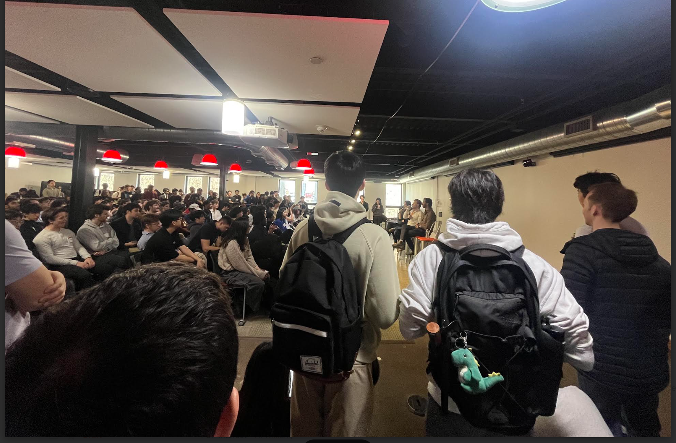
TRACTION
Early Signals: Demand Already Validated
Lack of funding is a common problem among college student startups — validated firsthand through Startup Hours, which saw dozens of founders who would have used a program like this.
Non-dilutive funding grants are a drawn-out, time-consuming process — startups move faster than grants and pitch competitions.
Current pipeline: Cornell founders in the Cornell Entrepreneurship Club will complete their cohort in November 2026 and seek investor funding
Securing an investor early accelerates a startup’s fundraising trajectory in future rounds.
Venture Catalyst can bring the Bay Area’s culture of entrepreneurship and access to capital to more communities and universities across the country.
VENTURE CATALYST
5

Slide 6






TRACTION
If Venture Catalyst Existed Sooner…
YC startups that would’ve been in my network or the Cornell Network assuming this launched the 2025-2026 academic year.
Monarcha
GradeWiz
EffiGov
YC S25
YC W25
YC S25
Spotlight Realty
Pares
Candytrail
YC S25
YC S25
YC S25
VENTURE CATALYST
27

Slide 7
MARKET TIMING
Why Now
Exits
Vibe Coding / Funding Shifts
More opportunities to exit at different sizes and stages, through various forms.
It’s cheaper than ever to build — less capital is needed to reach the same milestones.
Tighter VC Rounds
Concentration in Large Rounds
Less traditional VC funding is available at the earliest stages.
Funding concentrated in large, later check sizes leaves a void for early-stage startups — especially no-code and low-code ones.
VENTURE CATALYST
22

Slide 8
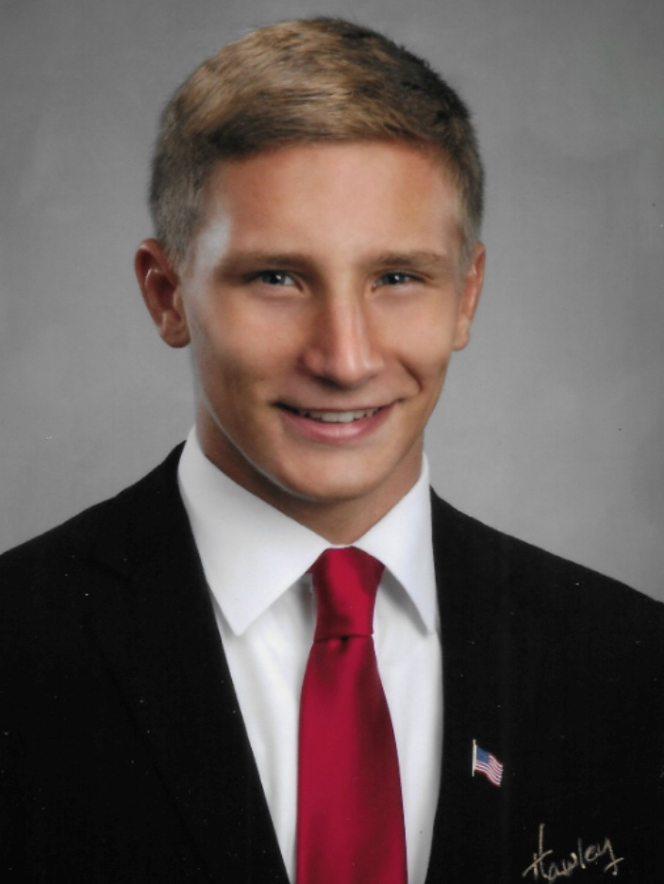









TEAM
Why I’m Building This
1
Background
Cornell University- Charles H. Dyson School of Applied Economics and Management
Associate at EY-Parthenon focused on Transactions and Corporate Finance
E-Board Member of Cornellians in VC
Campus Scout at Collide Capital
Venture Scout at Discipulus Ventures
Associate at Gorges Ventures
President of Ventures Accelerated and Vice President of Cornell Entrepreneurship Club
2
Why Me
“As a student founder and running organizations to support founders, I saw the gap in in funding for early-stage student entrepreneurs their limited access capital inspiring me develop Venture Catalyst.”
Built and ran Startup Hours at Cornell, working directly with dozens of early-stage student founders.
Organized YC events , 1517 Fund events to build the Cornell entrepreneurship ecosystem.
Embedded in the Cornell startup ecosystem, with existing relationships across founders, alumni, and angel investors.
Partnered with with Cornell Entrepreneurship Club and Cornell Armada to
In addition to Cornell connections, I have ability to leverage ATL and GA Tech connections o scale beyond Cornell
VENTURE CATALYST
6

Slide 9
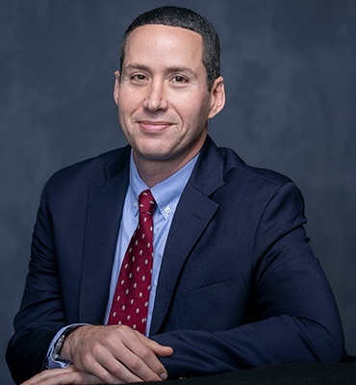
TEAM
Advisors
Professor, Cornell University
Former Head of Economics, Homebase
Startup Advisor
VENTURE CATALYST
7

Slide 10
MODEL
Venture Catalyst can combine our core thesis with several key market trends to build a unique concept.
Typical college startups
Pre-Accelerator and Before Pre-Seed
Student founders offer significant potential and a demonstrated need for capital while being overlooked by traditional venture capital.
The opportunity to invest in a startup as the first money on the cap-table and benefit from future upside that is no longer available when a startup completes an accelerator.
Overlooked Geographies
Overlooked Sectors
Venture Capital as an industry is skewed towards a few geographies and in terms of college students it favors a few universities.
Positioned to unique fill a void of overlooked sectors where companies have the potential to reach scale or build an enduring business. This includes hardware, CPG and Consumer Tech coupled with AI + SaaS startups giving broad diversification.
VENTURE CATALYST
22

Slide 11
MODEL
Structure + Implementation Roadmap
1
2
3
Start with warm introductions to potential angel investors to Cornell startups seeking investment.
Actively recruit Cornell investors and refine the startup pipeline/screening.
Launch with a newsletter and website with a base of investors and startups.
4
5
6
Establish a legal structure to facilitate investor-founder introductions.
Launch and scale beyond Cornell and our network.
Assess the success and traction to determine next steps.
VENTURE CATALYST
28

Slide 12
MODEL
Structure — The Value Add
SAFE Note
Strategic Angel + Value-Add Investor
Use a YC-like SAFE note — uncapped or Capped, MFN, with pro rata options. Venture Catalyst and suggest a structure but the details fall on investor + founder. Venture Catalyst does not coordinate investments or act as a broker-dealer initially; a side letter later grants right of first refusal to participate in the startup’s first priced round through an SPV.
Side Letter for Investor
Gives angel investors the option to advise and mentor startups, with defined requirements and parameters.
Venture Catalyst differentiates itself from other funding sources and VCs by align founders to an angel investors who can dd value through their network and connections. Student founders are uniquely positioned to benefit from the mentorship and support that strategic and value-add angel investor can bring. We can help you reach your first customer and revenue.
We believe that value-add angel investors for student founders who an invest across the company life-cycle in later stages is a key differentiator.
Angel Squad’s one-investor-per-startup model shows this mechanic works; Venture Catalyst adds a dedicated mentorship layer on top.
VENTURE CATALYST
10

Slide 13
OTHER MODELS / COMP
How Venture Catalyst Differs From the Alternatives
Breakthrough Ventures leaves a void — it acts as an accelerator with limited spots, focused on tech and the Bay Area.
Atland Ventures is a student-run fund with $2M AUM, launched in part by raising from alumni to invest in startups solving problems faced by Gen Z. It demonstrates the ability to successfully partner with alumni to invest in startups.
Startups outside of the Bay Area
Student founders who can’t easily travel to, or work around, an accelerator’s timeline
As demonstrated by other funds — including the Dorm Room Fund and VC fellowship programs like Collide Capital — partnering with college students is an effective way to build a sourcing pipeline.
Venture Catalyst is distinctive in that it is not a typical accelerator or fund that has capital as a main value-add. Comparable funds demonstrates the success of the thesis of investing in students in smaller check sizes and the unique ability for Gen Z founders to succeed in certain sectors. The VC sourcing pipeline through university partnerships is proven method for major funds such as General Catalyst, dorm Room Fund and Collide Capital.
VENTURE CATALYST
11

Slide 14
PROJECTIONS
The Markup: From First Check to Priced Round
Assume Venture Catalyst supports a founder who is then admitted into Y-Combinator (likely a few months after)
Illustrative example — a $25,000 check through Venture Catalyst’s $5M-cap SAFE, marked at the startup’s $20M post-money cap in YC
$100,000
+$75,000 · 4.0x markup
$25,000
Initial SAFE check
$5M cap · 0.5% implied ownership
Marked value at a YC $20M cap post-money
SAFE 0.5% ownership retained
Same dollars invested, same ownership percentage — the paper value moves 4.0x purely from the SAFE cap stepping up from $5M to $20M.
VENTURE CATALYST
12

Slide 15
THE ASK
Join Venture Catalyst’s Founding Circle
Founding Angels
Warm Intros
Advisors & Mentors
Founding Angels
Warm Intros
Advisors & Mentors
Join our network and consider investment in a Venture-Catalyst-sourced startup
Introductions to Startups, alumni in venture capital, entrepreneurship or any potential partners
Experts willing to support founders through the network
Join our network and consider investment in a Venture-Catalyst-sourced startup
Introductions to Startups, alumni in venture capital, entrepreneurship or any potential partners
Experts willing to support founders through the network
We are seeking startups, investors, introductions, feedback and support to build out the funding and legal structure to professionalize Venture Catalyst to be an enduring venture.
VENTURE CATALYST
39

Slide 16
Cornell and Beyond
`
Start with my network and connections- a small group of Cornell startups
Scale to other universities
and Gen Z startups
Extend the reach to fully encompass the Cornell University ecosystem

Slide 17
PROJECTIONS
Year 1 Targets
Directional targets, not guarantees — sized as we build
Q4 2026
Q1 2027
Q2 2027
Q3 2027
End of Year 1
[X] founding angels recruited; newsletter live with [X] subscribers.
[1–2] startup-investor matches closed; [X] startups in active pipeline.
Legal framework live; [$X] in capital facilitated to date.
Expand beyond Cornell to [X] additional university networks.
[X] total matches made; [$X] in capital facilitated; [X] startups tracked toward pre-seed or an accelerator.
→
→
→
→
VENTURE CATALYST
12

Slide 18
MODEL
Potential Model: The Reverse Hustle Fund
HUSTLE FUND MODEL
VENTURE CATALYST MODEL
Build a network of investors like Hustle Fund — but reversed. They invest in startups as the first check, pooling multiple investors to collectively equal a standard round.
We match one investor with one startup.
Venture Catalyst serves as the first check through one dedicated angel investor — for startups earlier than pre-seed — to help them launch.
VENTURE CATALYST
9

Slide 19
GO-TO-MARKET
Roadmap: Launch at Cornell, Then Scale
1
2
3
Q4 2026 — Start with warm introductions to potential angel investors and Cornell startups seeking investment; beta test with a small group.
Q1 2027 — Actively recruit Cornell investors, refine the startup pipeline/screening, and land the first successful match.
Q1–Q2 2027 — Launch a newsletter and website with an initial base of investors and startups; deepen ties with Cornell entrepreneurship groups and alumni in VC.
4
5
6
Q2 2027 — Establish the legal structure (SAFE note, side letter, AngelList docs) to facilitate investor-founder introductions.
Q3 2027 — Launch and scale beyond Cornell to other universities and our broader network, with a scout/referral system.
End of Year 1 — Assess success and traction (matches made, capital deployed, network growth) to determine next steps.
VENTURE CATALYST
8

